Slide 1
Drupal 9 Database Api

Slide 2
Drupal Database configuration
The primary means of defining a database connection is via the $databases array in settings.php.
Connection key
$databases['default'] // The database connection.
$databases['default']['default'] = array(
'driver' => 'mysql',
'database' => 'drupaldb',
'username' => 'username',
'password' => 'secret',
'host' => 'localhost',
);
SECTION TITLE

Slide 3
Initiating DB connection
In the Procedural code, i.e. *.module, *.inc or script files:
The best way to instantiate a database connection object is via the Service Container.
Example:
$database = \Drupal::database();
// Or
$database = \Drupal::service('database');
Content Entity
In OOP code:
In some cases a database connection object may already be available as a member on the current class; for example, many plugins and services have $this->database (or$this->connection) - the database connection object as a member.
If it is possible, use DI (dependency injection) to use @database service or $container->get('database'); to inject the database connection
SECTION TITLE

Slide 4
Static Queries
$database = \Drupal::database();
$query = $database->query("SELECT id, example FROM {mytable}");
$result = $query->fetchAll();
Arguments
The query() method of a database connection object takes three arguments:
$query: the query to run. Use placeholders where appropriate and denote all table names with curly braces.
$args: an array of placeholder values to substitute into the query.
$options: an array of options to control how the query operates (optional).
SECTION TITLE

Slide 5
Static Queries
$result = $database->query("SELECT * FROM {mytable} WHERE id IN (:ids_1, :ids_2, :ids_3)", [
':ids_1' => 13,
':ids_2' => 42,
':ids_3' => 144,
]);
SECTION TITLE

Slide 6
Dynamic Queries
$database = \Drupal::database();
$query = $database->select('users', 'u');
// Add extra detail to this query object: a condition, fields and a range.
$query->condition('u.uid', 0, '<>');
$query->fields('u', ['uid', 'name', 'status', 'created', 'access']);
$query->range(0, 50);
SECTION TITLE

Slide 7
Dynamic Queries
Shorthand:
/ Create an object of type Select.
$query = $database->select('users', 'u');
// Add extra detail to this query object: a condition, fields and a range.
$query->condition('u.uid', 0, '<>')
->fields('u', ['uid', 'name', 'status', 'created', 'access'])
->range(0, 50);
SECTION TITLE

Slide 8
Dynamic Queries
Joins:
$query = $connection->select('node', 'n', $options);
$query->join('node_field_data', 'nfd', 'n.nid = nfd.nid AND nfd.status = :status', array(':status' => 1));
$table_alias = $query->join('users', 'u', 'n.uid = u.uid AND u.uid = :uid', array(':uid' => 5));
Group By:
$query = $connection->select('node', 'n')
->fields('n',['uid']);
$query->addExpression('count(uid)', 'uid_node_count');
$query->groupBy("n.uid");
$query->having('COUNT(uid) >= :matches', [':matches' => 2]);
$results = $query->execute();
SECTION TITLE

Slide 9
CRUD
Insert
$result = $connection->insert('mytable')
->fields(['title', 'uid', 'created'])
->values([
'title' => 'Example',
'uid' => 1,
'created' => \Drupal::time()->getRequestTime(),
])
->execute();
SECTION TITLE

Slide 10
Delete:
Update:
$num_updated = $connection->update('mytable')
->fields([
'field1' => 5,
'field2' => 1,
])
->condition('created', REQUEST_TIME - 3600, '>=')
->execute();
Delete:
$num_deleted = $connection->delete('mytable')
->condition('myfield', 5)
->execute();
SECTION TITLE

Slide 11
DB Result Set:
https://www.drupal.org/docs/8/api/database-api/result-sets
SECTION TITLE

Slide 12
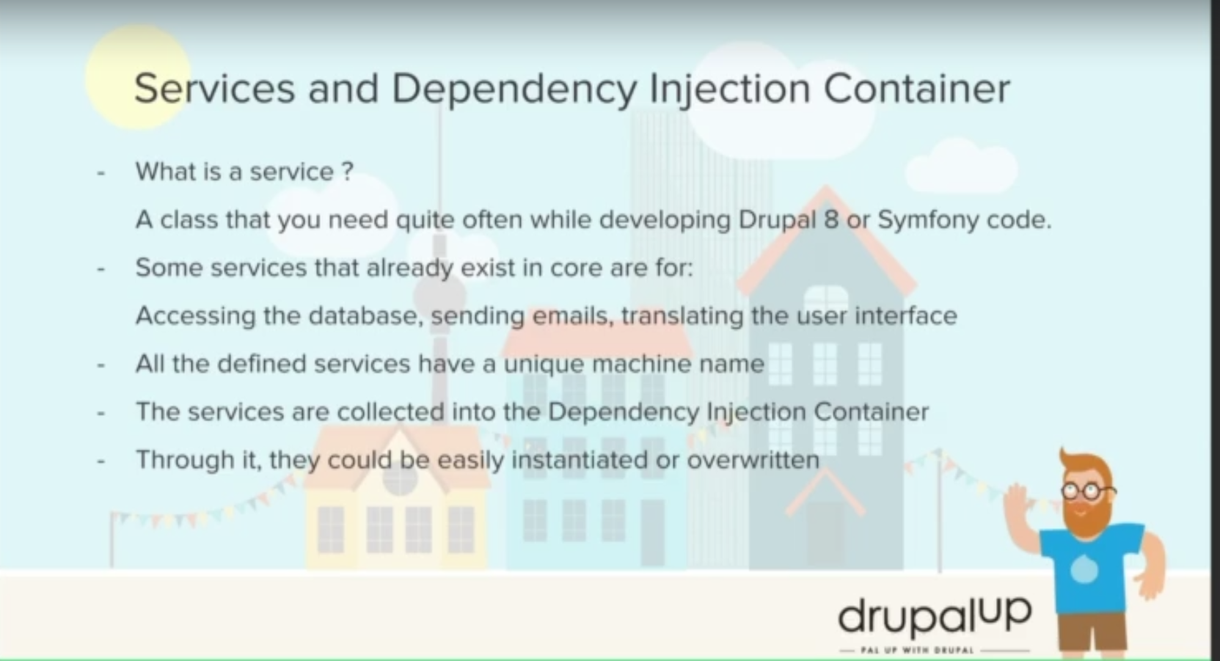
Services:
SECTION TITLE

Slide 13
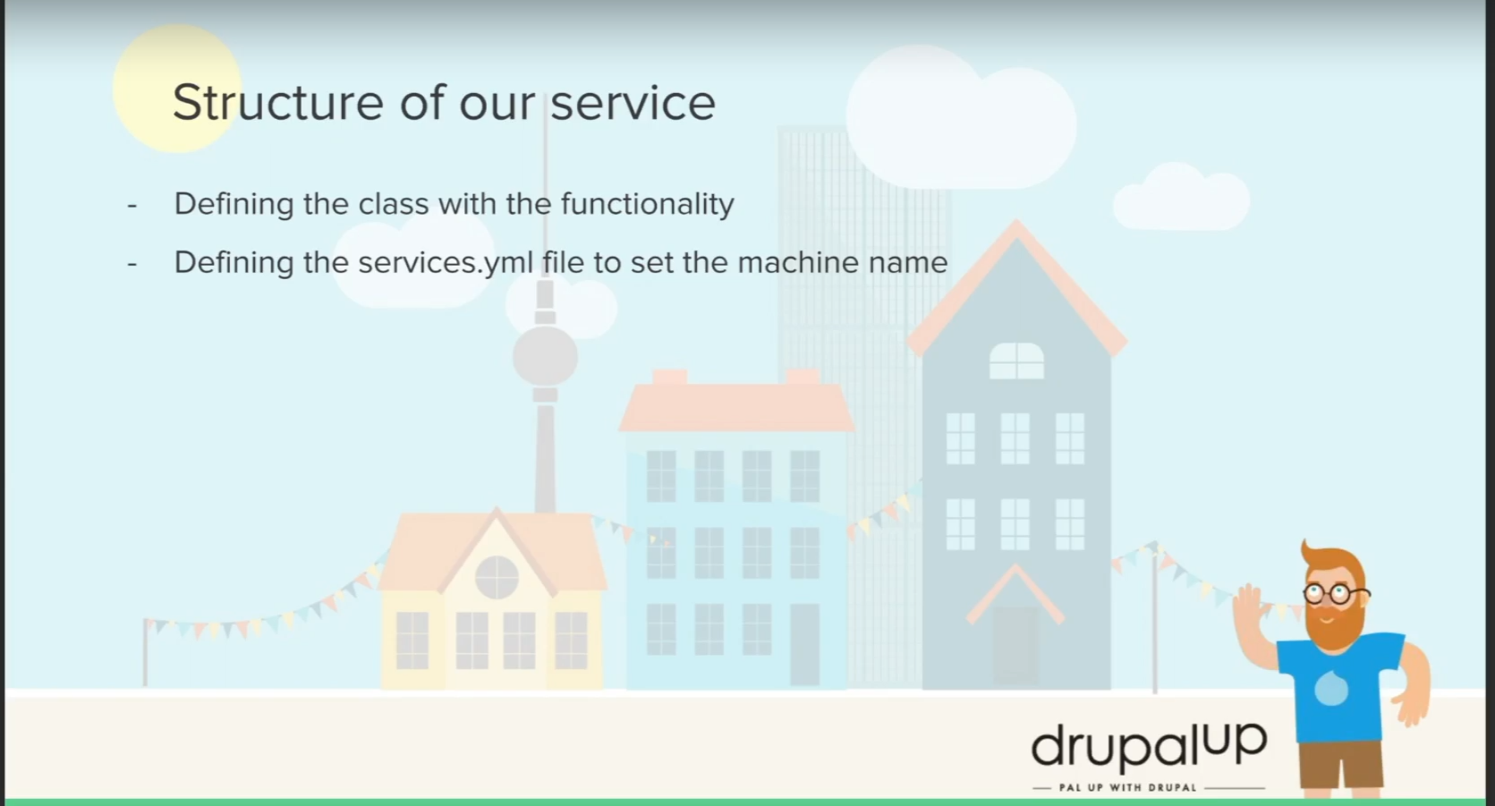
Services:
Structure

Slide 14
Reference:
https://cognizant.udemy.com/course/drupal-8-module-development/learn/lecture/10268932?start=450#overview

